Slide 1
How God Speaks
Hebrews 1:1-2

Slide 2
In the Beginning
God created and communicated
Genesis 1:1, “In the beginning God created the heavens and the earth.”
Genesis 1:6, “And God said, Let there be a firmament in the midst of the waters, and let it divide the waters from the waters.”

Slide 3
In the Beginning
God created and communicated – Continued
Genesis 1:26-27, “And God said, Let us make man in our image, after our likeness: and let them have dominion over the fish of the sea, and over the birds of the heavens, and over the cattle, and over all the earth, and over every creeping thing that creepeth upon the earth. And God created man in his own image, in the image of God created he him; male and female created he them.”

Slide 4
In the Beginning
God spoke to man and woman
Genesis 2:16-17, “And Jehovah God commanded the man, saying, Of every tree of the garden thou mayest freely eat: but of the tree of the knowledge of good and evil, thou shalt not eat of it: for in the day that thou eatest thereof thou shalt surely die.”

Slide 5
In the Beginning
God spoke to man and woman – Continued
Genesis 3:2-3, “And the woman said unto the serpent, Of the fruit of the trees of the garden we may eat: but of the fruit of the tree which is in the midst of the garden, God hath said, Ye shall not eat of it, neither shall ye touch it, lest ye die.”
Mankind understood God’s instructions!

Slide 6
Patriarchal Times
God spoke to the Patriarchs
God spoke to Abram – Genesis 12:1, “Now Jehovah said unto Abram, Get thee out of thy country, and from thy kindred, and from thy father’s house, unto the land that I will show thee.”
God spoke to Isaac – Genesis 26:1-3, “And there was a famine in the land, besides the first famine that was in the days of Abraham. And Isaac went unto Abimelech king of the Philistines, unto Gerar. And Jehovah appeared unto him, and said, Go not down into Egypt; dwell in the land which I shall tell thee of: sojourn in this land, and I will be with thee, and will bless thee; for unto thee, and unto thy seed, I will give all these lands, and I will establish the oath which I sware unto Abraham thy father.”

Slide 7
Old Times
God spoke to the people through prophets
Hebrews 1:1, “God, having of old time spoken unto the fathers in the prophets by divers portions and in divers manners, hath at the end of these days spoken unto us in [his] Son, whom he appointed heir of all things, through whom also he made the worlds.”

Slide 8
Old Times
God spoke to the people through prophets – Continued
What is a prophet?
Exodus 4:15, “And thou shalt speak unto him, and put the words in his mouth: and I will be with thy mouth, and with his mouth, and will teach you what ye shall do. And he shall be thy spokesman unto the people; and it shall come to pass, that he shall be to thee a mouth, and thou shalt be to him as God.”

Slide 9
Old Times
God spoke to the people through prophets – Continued
Major Prophets – 5
Minor Prophets – 12
Not due to importance or accomplishments, but rather because of the size of the books

Slide 10
New Testament Times
New Testament Prophets
Luke 1:76, “Yea and thou, child, shalt be called the prophet of the Most High: For thou shalt go before the face of the Lord to make ready his ways.”
This is speaking of John the Baptist, he prepared the way for Jesus to come.
We read of others – Acts 15:32, Judas and Silas

Slide 11
New Testament Times
New Testament Prophets – In the Church
Ephesians 3:3-5, “How that by revelation was made known unto me the mystery, as I wrote before in few words, whereby, when ye read, ye can perceive my understanding in the mystery of Christ; which in other generations was not made known unto the sons of men, as it hath now been revealed unto his holy apostles and prophets in the Spirit.”

Slide 12
New Testament Times
Why were there prophets in the New Testament Church?
1 Corinthians 13:8-10, “Love never faileth: but whether [there be] prophecies, they shall be done away; whether [there be] tongues, they shall cease; whether [there be] knowledge, it shall be done away. For we know in part, and we prophesy in part; but when that which is perfect is come, that which is in part shall be done away.”

Slide 13
New Testament Times
The revelation process
2 Peter 1:20-21, “Knowing this first, that no prophecy of scripture is of private interpretation. For no prophecy ever came by the will of man: but men spake from God, being moved by the Holy Spirit.”
The Holy Spirit revealed and men spoke what they heard!

Slide 14
New Testament Times
The revelation process – Continued
Ephesians 3:3-5, “How that by revelation was made known unto me the mystery, as I wrote before in few words, whereby, when ye read, ye can perceive my understanding in the mystery of Christ; which in other generations was not made known unto the sons of men, as it hath now been revealed unto his holy apostles and prophets in the Spirit.”
The message revealed was written down for others to read!

Slide 15
In Modern Times
God speaks through His Son in the New Testament
Hebrews 1:1, “God, having of old time spoken unto the fathers in the prophets by divers portions and in divers manners, hath at the end of these days spoken unto us in [his] Son, whom he appointed heir of all things, through whom also he made the worlds.”

Slide 16
In Modern Times
God speaks through the New Testament
Jude 3 “Beloved, while I was giving all diligence to write unto you of our common salvation, I was constrained to write unto you exhorting you to contend earnestly for the faith which was once for all delivered unto the saints.”
The New Testament standard is permanent!

Slide 17
In Modern Times
There are no modern prophets
Deuteronomy 18:20-22, “But the prophet, that shall speak a word presumptuously in my name, which I have not commanded him to speak, or that shall speak in the name of other gods, that same prophet shall die. And if thou say in thy heart, How shall we know the word which Jehovah hath not spoken? when a prophet speaketh in the name of Jehovah, if the thing follow not, nor come to pass, that is the thing which Jehovah hath not spoken: the prophet hath spoken it presumptuously, thou shalt not be afraid of him.”

Slide 18
In Modern Times
There are no modern prophets
Charles Taze Russell – Founded the Jehovah’s Witness religion
Passed away in 1916
Judge Joseph F. Rutherford – Began lectures in 1918 saying “Millions now living will never die”
Eventually published in a book
Believed in a resurrection of the patriarchs and Old Testament prophets from Hebrews 11.
It never happened! He was a false prophet.

Slide 19
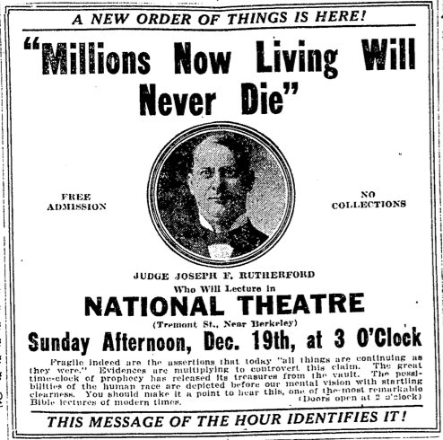
In Modern Times

Slide 20
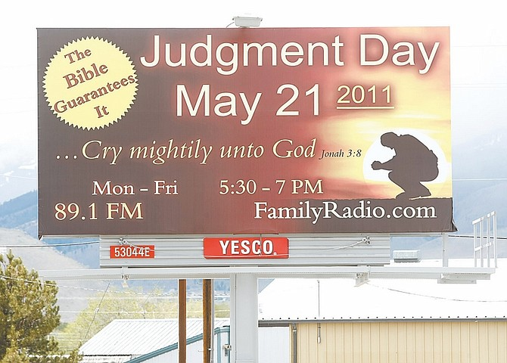
In Modern Times

Slide 21
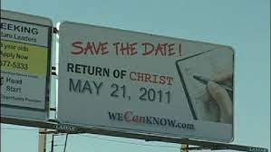
In Modern Times

Slide 22
Why is this Important?
We must understand how God speaks today!
We cannot afford be led astray
Many today claim, falsely, to be prophets!
The New Testament contains the standard of truth we need to cling to

Slide 23
What have the New Testament apostles and prophets revealed?
  There is a process to becoming a Christian!
  Hear – Romans 10:17
  Believe – Hebrews 1:1-2; John 3:16
  Repent – Luke 13:3; Acts 2:38
  Confess – Romans 10:9-10
  Be Baptized – Acts 2:38; Mark 16:15-16

Slide 24
What have the New Testament apostles and prophets revealed?
  We Must Remain Faithful (Revelation 2:10)
  We must abide in the doctrine of Christ (2 John 9)
  We must continue in the apostles teaching (Acts 2:42)
  We must repent when we fall and pray for forgiveness (Acts 8:22)

